Slide 1


Aspect-Based Sentiment Analysis (ABSA) for Restaurant Reviews
A Comprehensive NLP Approach
by Nabarun Barua

Slide 2


Introduction and Objectives
Understanding Customer Sentiment
Aspect-Based Sentiment Analysis
This project aims to analyze customer feedback on restaurants, focusing on aspects like food, service, ambiance and etc.
We will develop a pipeline to extract aspect terms, determine their polarity, and detect aspect categories.

Slide 3

Case Study Overview
1
Dataset
The dataset comprises 3,000 annotated English customer reviews for a restaurant.
2
Annotations
The annotations include aspect terms, their polarity, and their corresponding categories.
3
Key Deliverables
Our objectives include developing a robust ABSA model, analyzing the results to uncover actionable insights for the restaurant, and proposing improvements to the ABSA pipeline.
4
Model Used
Due to limited resources, we will leverage a pre-trained model previously fine-tuned on a Restaurant dataset for a different task. This model serves as a baseline, and we will further fine-tune it on our dataset for the specific tasks we have identified.

Slide 4



ABSA Model Architecture Overview
NER Model
1
Extracts aspect terms
Sentence Inferencing Model
2
Determines sentiment polarity
Multi-Label Model
3
Classifies reviews into categories
The model architecture consists of three components: NER, Multi-Label, and Sentence Inferencing. These models are integrated sequentially to extract aspects, determine polarity, and categorize reviews.

Slide 5
Aspect Extraction (NER Model)
Approach
1
Named Entity Recognition (NER)
Techniques
2
Tokenization, Multi-word aspect term handling
Model Training
3
Annotated reviews, Precision, Recall, F1-score
This slide focuses on the aspect extraction component of the ABSA model. The approach utilizes Named Entity Recognition (NER) to identify specific restaurant-related aspects within customer reviews. The model leverages techniques such as tokenization and multi-word aspect term handling to accurately extract these aspects. Model training is conducted using a dataset of annotated reviews & Terms, and the performance is evaluated using metrics such as precision, recall, and F1-score.

Slide 6
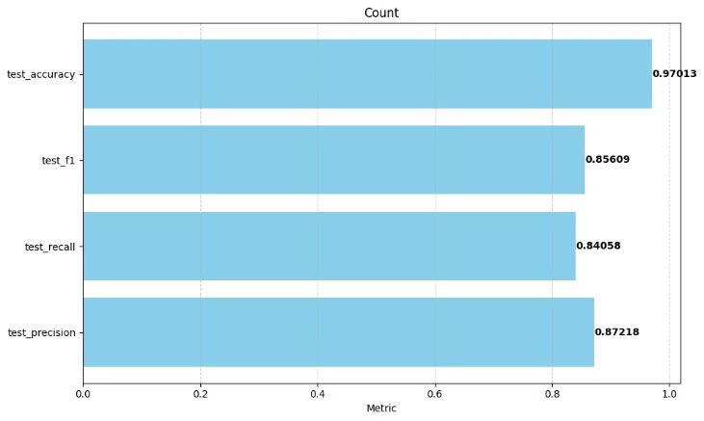
Aspect Term(NER)
This slide focuses on evaluating the performance of the Named Entity Recognition (NER) model on unseen data used for aspect extraction. Key metrics are used to assess the model's effectiveness.

Slide 7


Aspect Category Detection (Multi-Label Model)
Approach
This model assigns reviews to categories like food, service, price, ambiance, and anecdotes/miscellaneous.
Challenges Addressed
Identifying coarse-level category assignment: Reviews may use words that don’t directly match category names. For example, "The place was too crowded" should be mapped to the *ambiance* category.
Assigning multiple categories to a single review: A review can discuss more than one aspect category. For example, "The food was amazing, but the service was slow, and the ambiance was too loud." This review mentions three different categories: *food*, *service*, and *ambiance*.

Slide 8
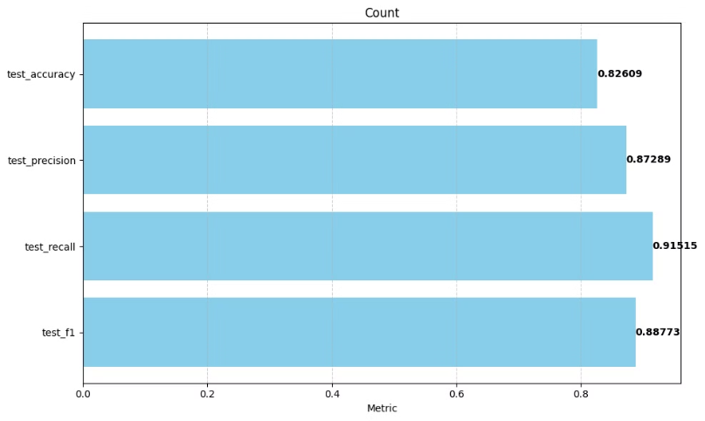
Aspect Category Detection (Multi-Label Model)
This slide highlights the evaluation of the Multi-Label model on new, unseen data used to predict categories for customer reviews. Key performance metrics are used to assess the effectiveness of the model.

Slide 9
Aspect Polarity Classification
Approach
Model
Example
Used sentiment inferencing to classify aspect terms with User review into four polarities: positive, negative, neutral, and conflict.
Fine-tuned BERT for sentence-level sentiment analysis.
“I hated their fajitas, but loved their salads” → {fajitas: negative, salads: positive}

Slide 10
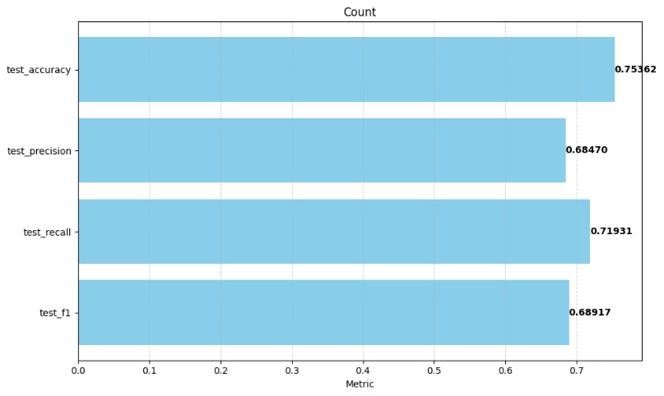
Aspect Polarity Analysis
This slide showcases the performance of our Sentence-Inferencing model when evaluated on unseen data, used to predict the sentiment of Aspect Terms for customer reviews. We assessed the model's effectiveness using key performance metrics. The test set achieved an F1 score of 0.64, while the unseen data achieved an F1 score of 0.69 (approximately).
While the model's performance is not ideal, we've explored using a large language model (LLM) for sentiment analysis. The next slide will delve into this approach.

Slide 11
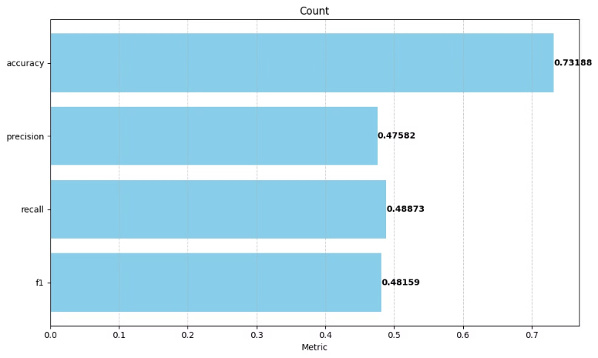
LLM-powered Polarity Analysis
Initially, we expected LLMs to outperform our BERT model in sentiment analysis. We evaluated the model using key performance metrics, but unfortunately, the results showed that it performed worse than the BERT model.

Slide 12
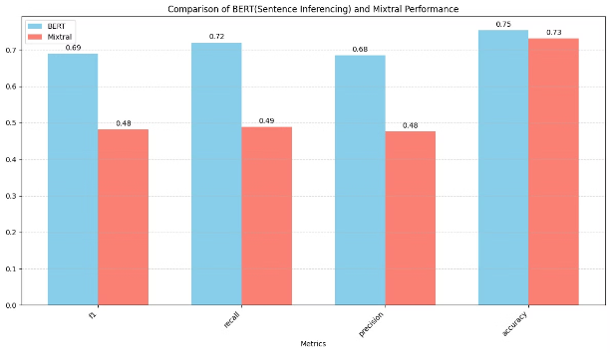
Observations & Mitigation
Our analysis of both models revealed a significant class imbalance, where the positive class dominated the results. This imbalance likely contributed to the observed performance metrics, specifically the lower F1, Recall, and Precision scores, despite a high Accuracy.
The positive class's prevalence resulted in class imbalance.
We employed macro averaging, which considers each class equally, leading to the observed metric scores.
To address the class imbalance, we can implement the following strategies:
Augment the dataset with more samples from other classes or use sampling techniques to balance the distribution.
Implement a customized loss function by assigning weights to each class to encourage the model to learn and accurately predict other classes.

Slide 13
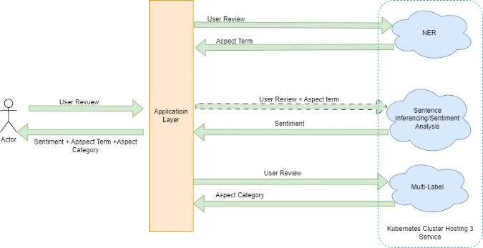
End-to-End Pipeline Deployment
This slide showcases the architecture of our deployed pipeline, which processes data from text input to aspect extraction, category detection, and sentiment analysis.
The pipeline leverages three key models: a Named Entity Recognition (NER) model for aspect extraction, a multi-label model for category detection, and a Sentence Inferencing model for sentiment polarity. These models are hosted on a Kubernetes service using a microservice architecture. An Application Layer facilitates communication with these services.
We utilized tools such as PyTorch, HuggingFace Transformers, FastAPI, Docker, Kubernetes, and BentoML or Azure Machine Learning for building and deploying this pipeline.

Slide 14

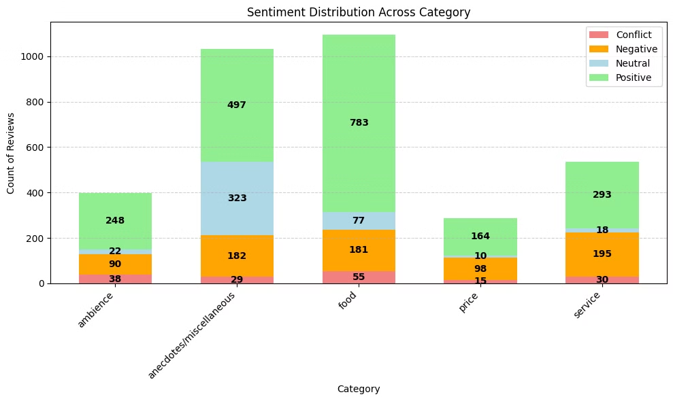
Data Analysis & Visualizations
Visualizations help us understand the sentiment distribution across different aspects, such as food, service, price, ambiance, etc. We can also visualize the sentiment polarity distribution, showing the percentage of positive, negative, neutral, and conflicting sentiments.
Our analysis shows that the restaurant receives very positive feedback for its food. However, the service category exhibits a 40% negative sentiment, indicating an area for improvement.
Additionally, a small group of customers (40%) have expressed concerns about pricing, presenting another opportunity for enhancement.
Finally, in the miscellaneous category, a combined 50% of users have expressed negative or neutral sentiment, warranting a deeper analysis to reduce either neutral or negative sentiment and increase positive sentiment.

Slide 15



Actionable Insights for the Restaurant
Positive Aspects
Negative Aspects
Neutral/Conflict Areas
Highlight areas like Food, Ambience, and Miscellaneous with positive sentiment to leverage these strengths.
Service needs improvement. Price-related complaints suggest a need to reconsider the pricing strategy.
Miscellaneous has mixed feedback, suggesting a deeper investigation is needed to identify areas for further improvement.

Slide 16

Pros & Cons of the Approach
Pros
Versatile model architecture.
Robust NER for extracting multi-word aspects.
Cons
Requires more domain-specific data for fine-tuning.
Potential class imbalance in sentiment labels.
The sentiment analysis model needs improvement.
Future Work
Address class imbalance using SMOTE or data augmentation.
Consider training the model with a weighted loss function to account for class imbalance.

Slide 17
Deployment Plan
Our deployment strategy involves training the model on a cloud platform such as AWS or GCP, or on-premise. This will be followed by deploying a real-time inference API for sentiment analysis, category classification, and aspect term extraction, enabling the models to process customer reviews in real-time. For ongoing dashboard updates, we will implement batch processing of reviews.
To ensure scalability, we will containerize the model and deploy it on Kubernetes. We will also implement continuous monitoring to track performance and facilitate ongoing model improvements.

Slide 18
Conclusion
Key Takeaways
Deployment Potential
Aspect-based sentiment analysis is crucial for understanding customer feedback. It provides actionable insights that can be used to improve customer satisfaction.
The ABSA pipeline is flexible and can be deployed across various domains. This makes it a valuable tool for businesses looking to gain a deeper understanding of their customers.

Slide 19

Questions and Discussion
We invite questions from the interviewers and encourage discussion on the approach.

Slide 20
Thank You

